Slide 1
CubeSat deorbit predictions
Jan 12, 2021

Slide 2
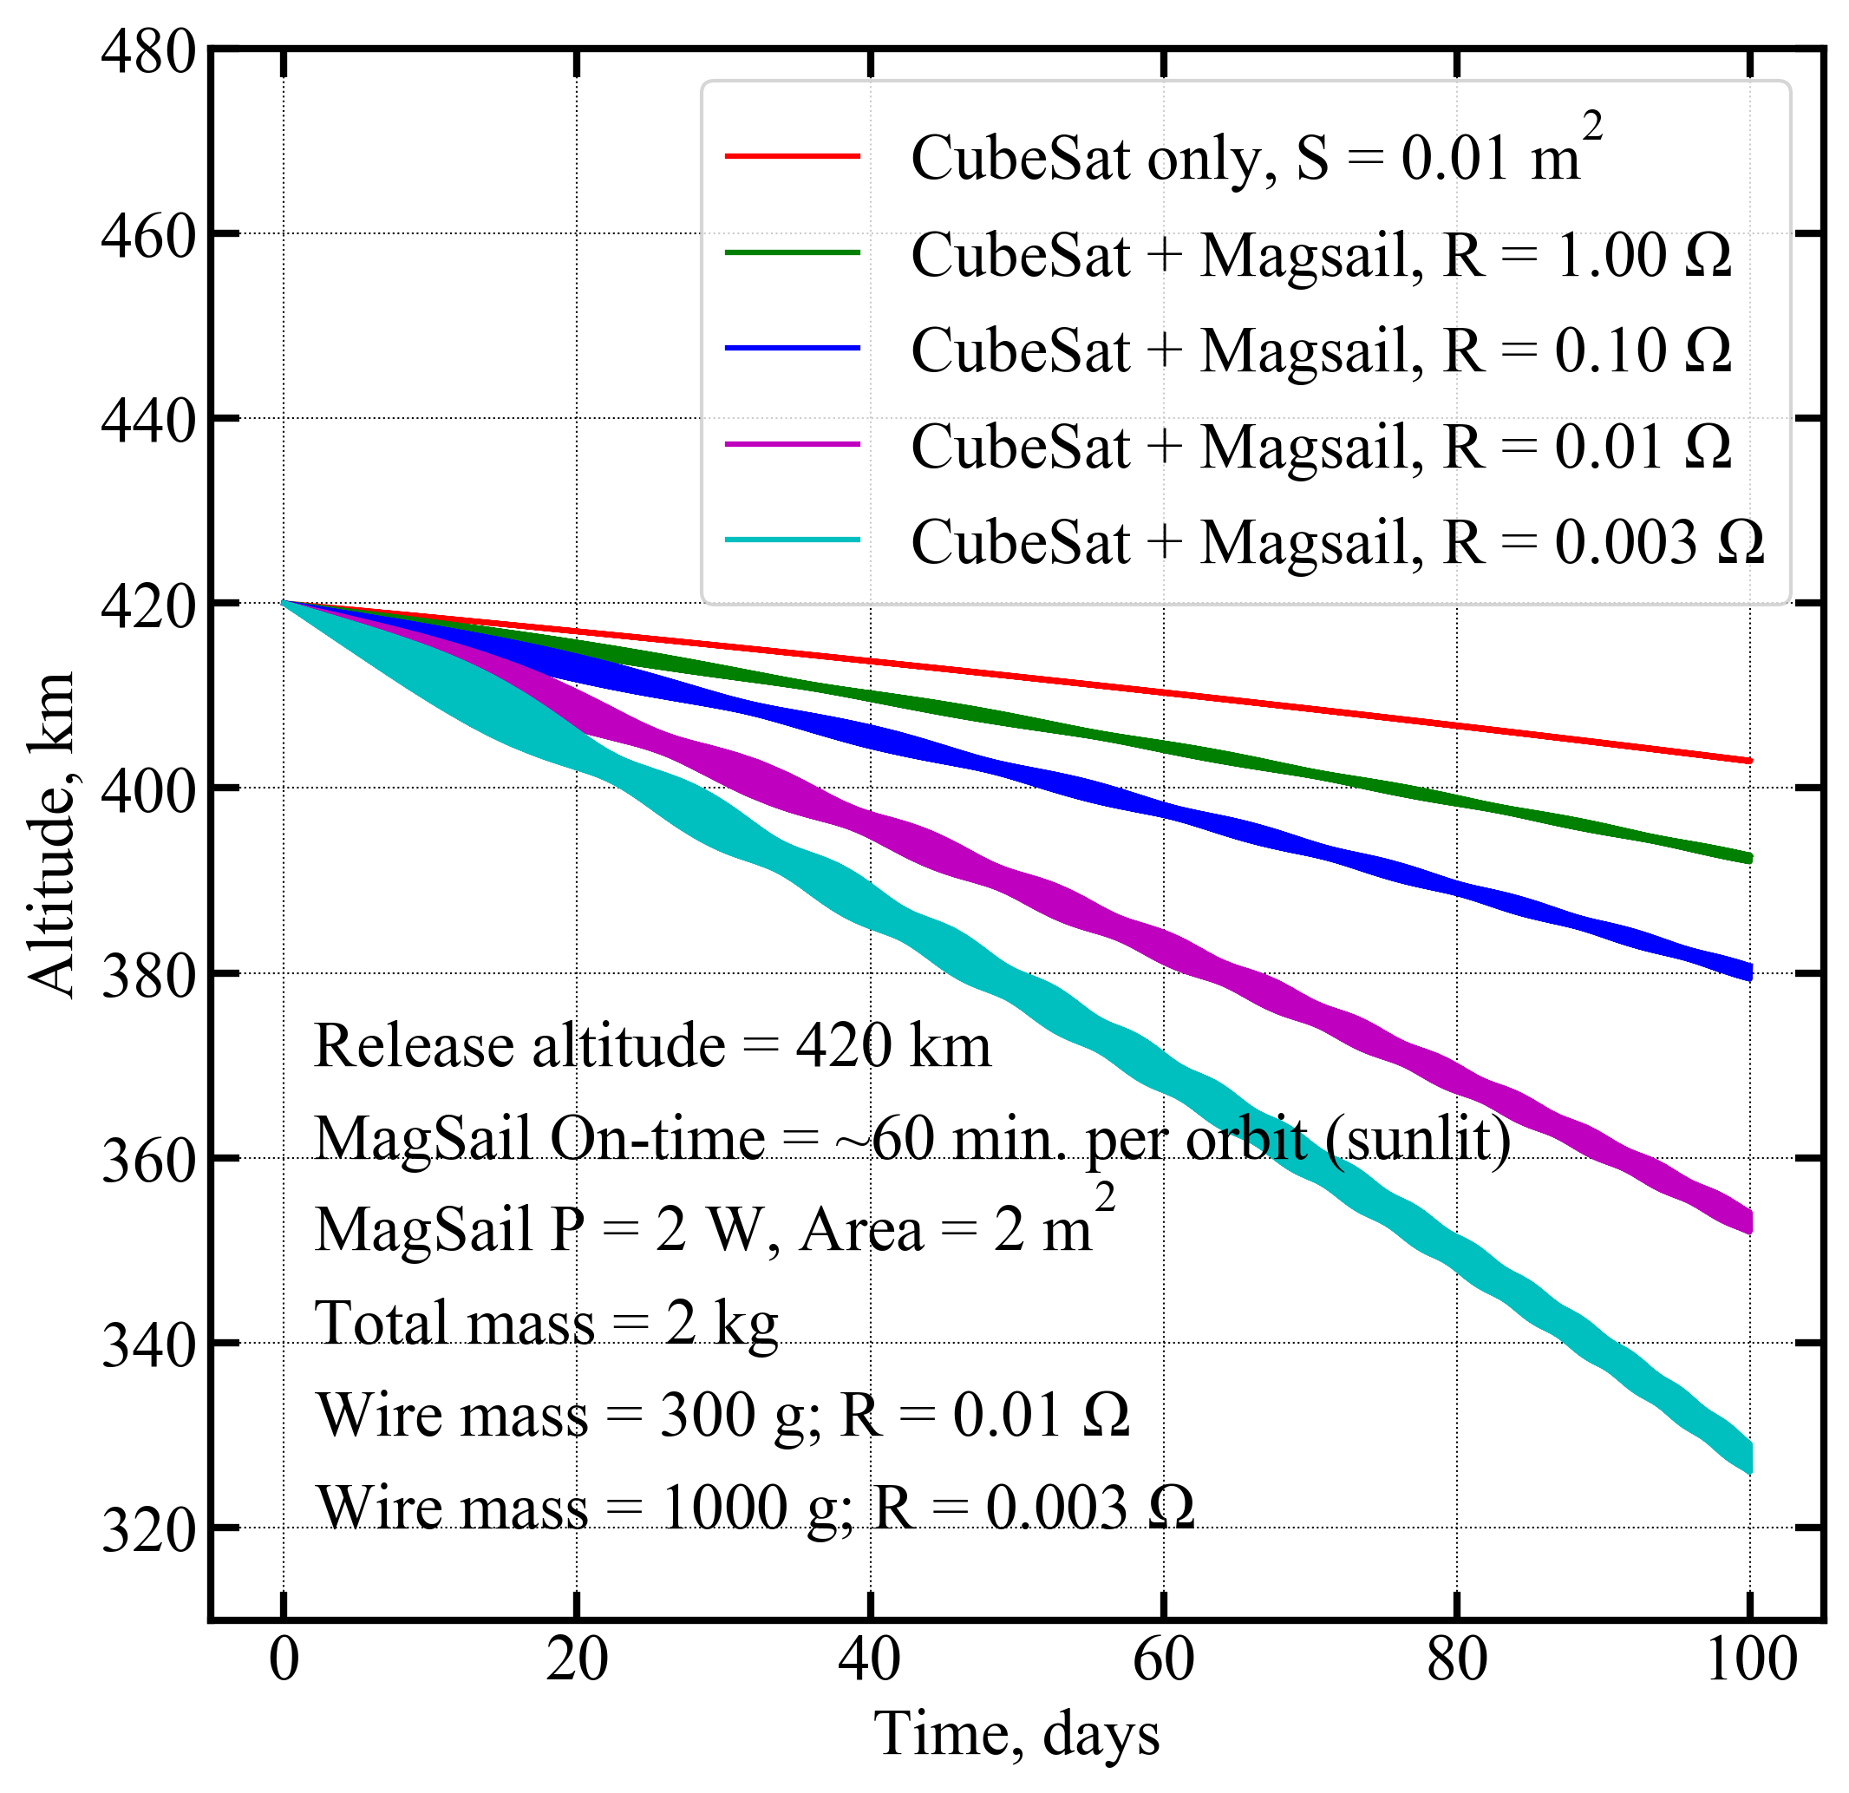
MHD model
Orbit drop
1 kg wire magsail is cyan curve

Slide 3
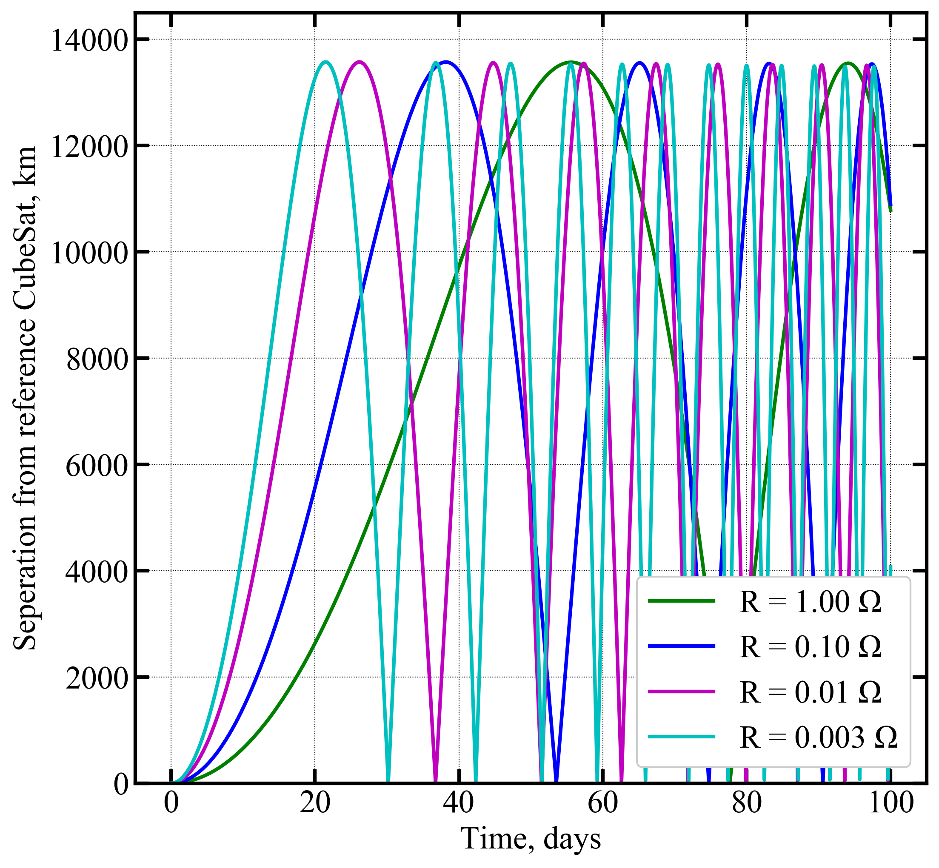
MHD model
Relative separation
1 kg wire magsail is cyan curve

Slide 4
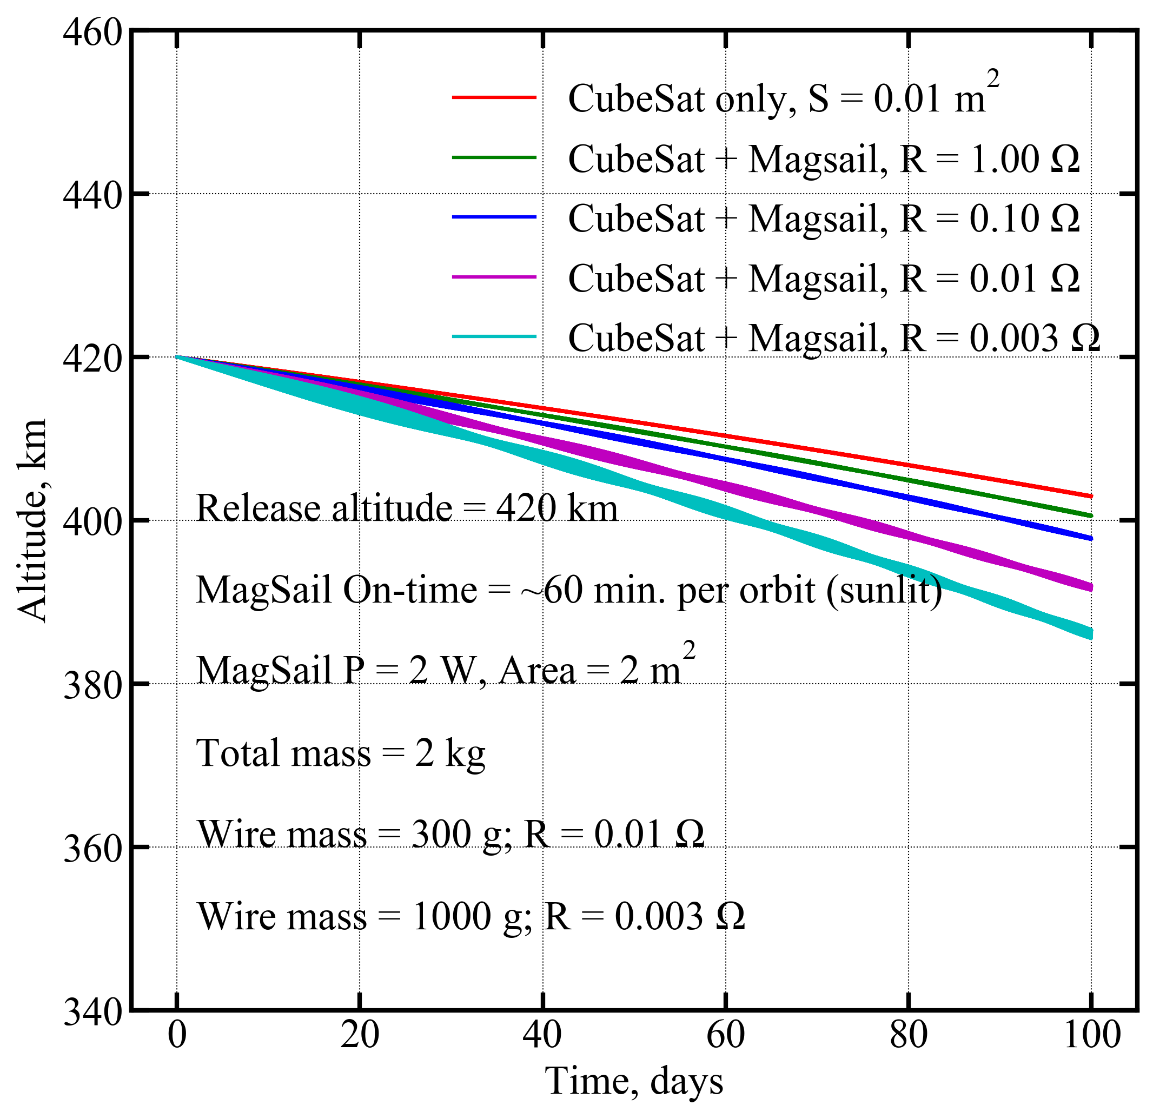
Magnetosphere boundary at B=B_ambient
1 kg wire magsail is cyan curve

Slide 5
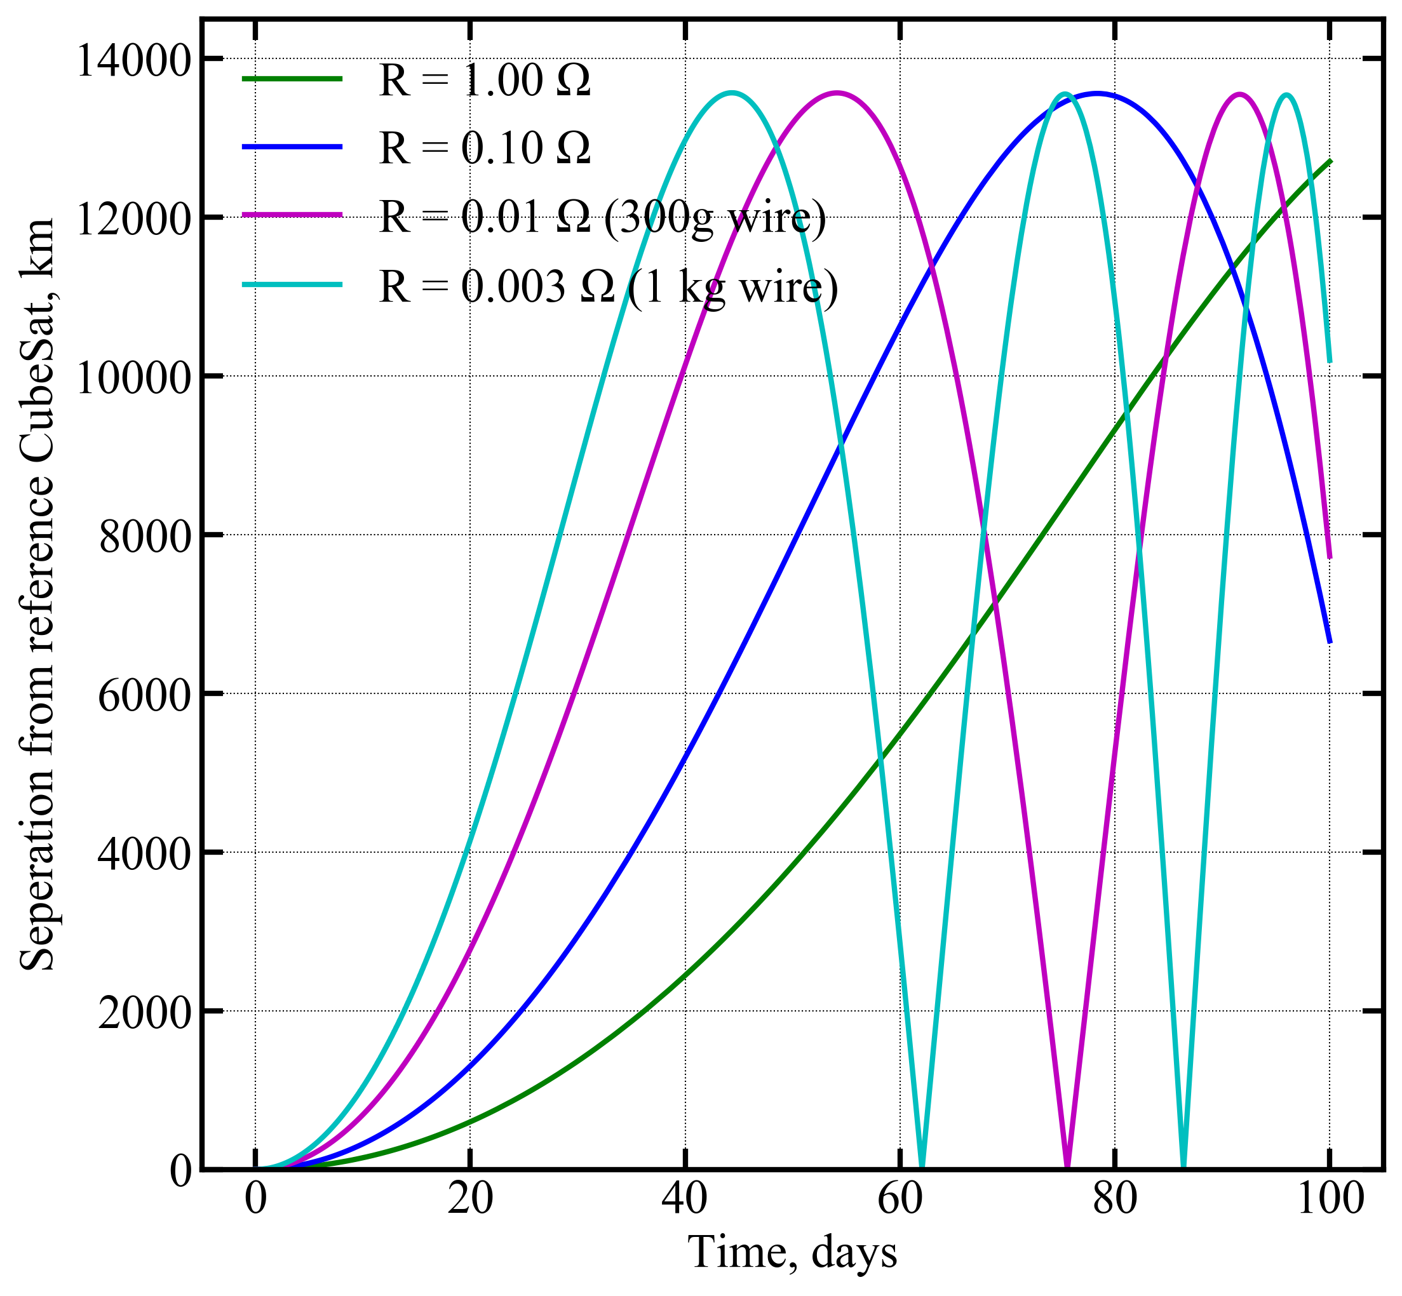
Magnetosphere boundary at B=B_ambient
relative separation
1 kg wire magsail is cyan curve

